Slide 1
Effects of Assistive Communication Training on Stereotypy with Individuals with ASD
Jacqueline Sura, MS BCBA STEPS Center for Excellence in Autism
Strongsville, Ohio USA
Notes:
-STEPS/Services
, where we have found barriers with our students
Philosophy that drives all student educational and program development
-describe procedures/protocol development
-

Slide 2
Behavior and Communication
Behavior IS communication
Prosocial vs. acting-out behaviors
Why does the behavior happen?
Because it has worked in the past to get a desired outcome
Limitations
Those without verbal communication
Those without total communication systems
Notes:
Examples of Prosocial behavior
-Holding the door for the person behind you…Why do we do this? What does this communicate to the person… it may communicate respect, manners, qualities of character. In return, we may get a smile, a thank you or the person may hold the next door for you. What would happen if you held the door for the person behind you and they refused to go in, what if the closed the door behind them, what if they yelled at you? If this happened enough would you continue to hold the door for those behind you.
What about smiling and greeting the person at a check out counter or customer service desk. Why do we do this?
Acting-out behaviors…How do individuals communicate a message through these. Let’s examine a few…Physically pushing another person away, what does that communicate “Leave me alone, go away” Flopping/dropping to the ground when a teacher gives a direction, what does that communicate.. “I don’t want to”. Running away or out of a classroom. What does that communicate, “I don’t want to be here”
-All of our outward actions communicate messages to an audience, the audience could be ourselves, one person or many
-How do individuals with limited vocal communication skills get their messages heard? Some may use sign language, text pictures or photos, voice output devices. What if the message still isn’t understood. How does one communicate “no I don’t want to, I’m in pain, this isn’t what I ordered”
What if the individual doesn’t have a total communication system? What could the behavior look like after 10, 20, 30 years without being able to communicate basic needs, preferences, medical ailments? How is this message communicated to the audience? Through maladaptive or acting out behaviors

Slide 3
Why is Communication so Hard to Learn?
An individual can’t see words as they are spoken
Complex syntax and grammar rules
The value of communication is typically not first aspect to be taught
Communication training can be extensive with outcomes that are not always immediate.

Slide 4
Tangible vs. Abstract
Individuals with ASD learn best with tangible concepts
Object identification
Numbers/Letters/Shapes
Engaging in activities
Abstract concepts are difficult for those with ASD
Theory of mind
Emotion identification
Future and past tense
Communication

Slide 5
Purpose of Our Investigation
The purpose of this study was to assess the effect of utilizing the phases of communication exchanges training for communication with an AAC (ProxTalker®), on defined stereotypic behaviors for two participants with histories of limited use to effective assistive communication.

Slide 6
Why the ProxTalker?
The LOGAN® PROXTALKER® communication device is an exciting mid-tech device which uses RFID technology to retrieve vocabulary stored on sound tags to produce REAL words.
From https://www.proxtalker.com/proxtalker

Slide 7
How to Make Communication Tangible?
ProxTalker makes communication tangible by using a multi-sensory approach
Tactile: user can touch flat or 3 dimensional tags
Motor planning: moving tags to location buttons
Visual: user can see the layout of communication structure on location buttons
Auditory: user can hear the words associated with tags and reinforce correct selection
Notes:
-How is traditional communication training not tangible
-traditional communication training can miss the mark in creating the value of what communication is meant to be and lead to universal and total communication system

Slide 8
About Participants
Two male students diagnosed with Autism Spectrum Disorder were selected for this study.
Both students had different levels of exposure to previous communication systems, but did not have an effective mode of total communication.
The students were also identified as exhibiting stereotypic behaviors that interfered with access to academic content.

Slide 9
Participants Continued
Participant 1- Donnie, 10 years old, had limited independent and effective communication. He also had previous exposure to a photo communication book and had not mastered Phase II of PECS.
Participant 2- Ronnie, 9, used verbalizations of phrases (prompted or spontaneous) as a primary mode of communication with no exposure to AAC.
Notes:
Explain baseline level of academic, communication, engagement, initiation skills

Slide 10
Modifications to Protocol
Addressing distance to device (proximity) at the end of the communication training.
Introduction of verbs/nouns related to requests taught with pre- academic targets related to receptive communication, visual performance, fine motor and engagement with others.
Descriptors, carrier phrases and commenting were not addressed until after predetermined criteria were met for generalization of requesting.

Slide 11
Response Targets
Vocal stereotypy examples included: nonfunctional vocalizations, echolalic responses, lips moving with/without audible sounds.
Motor stereotypy examples included: tapping surfaces, rubbing hands together in repetition, jumping up when not instructed, clapping when not functional and/or placing 1 or more fingers in clothing with a twisting motion.

Slide 12
Response Measurement
The effects of communication training using an AAC for stereotypic behaviors were measured using a time sampling procedure. In all phases, stereotypic behaviors were scored for presence or absence in 10 minute sessions divided into 15 second intervals.
A second observer was present for a minimum of 30 percent of all sessions to measure reliability.

Slide 13
Student 1: Results

Slide 14
Student 1: Results
The summary graph reflects that the amount of vocal stereotypy engagement did not decrease from the introduction of the communication device. Baseline Average: 44%, Intervention Average 51%
The summary graph does reflect that the amount of motor stereotypy engagement did decrease from the introduction of the communication device. Baseline average: 25%, Intervention average: 10%

Slide 15
Student 1: Results

Slide 16
Student 1: Anecdotal Notes
Staff members report that the amount of vocalizations increased throughout the school day.
Due to the student not currently having any recognized vocalizations as communication intent, any vocalization was recorded as stereotypy.
Could be counting vocalizations intended for communication as stereotypy.

Slide 17
Student 2: Results

Slide 18
Student 2: Results
The summary graph reflects that the amount of vocal stereotypy engagement did decrease from the introduction of the communication device. Baseline Average: 59%, Intervention Average 35%
The summary graph does reflect that the amount of motor stereotypy engagement did decrease from the introduction of the communication device. Baseline average: 50%, Intervention average: 19%

Slide 19
Student 2: Results

Slide 20
Student 2: Anecdotal Notes
After completion of Phase V, student demonstrated interest in a different communication mode.
ProxTalker is still used in conjunction with increased communication training with text.
Student has also been exposed and mastered modified phase VI around the classroom

Slide 21
Conclusions
For both participants there was a decrease in motor stereotypy with the use of the Logan®ProxTalker®
For both participants there was an increase in mastered Picture Exchange Communication Phases.
For both participants there was an increase in independent communicative intent, vocalizations for S1 and typing for S2.
For Student 2, there was also a decrease in vocal stereotypy
Notes:
-What was modified from traditional,
-identification of presrequisite skills

Slide 22
Acquisition

Slide 23
Additional Findings
Increased sample to one student in public school setting and one student in the private setting
Introduction of scene selection of pages on device
Embedding prerequisite academics and visual performance targets into communication instruction.
Found a decreased acquisition time of communication skills.
Made further modifications to initiation, proximity, sentence structure, pronouns.
Development of a protocol that emphasizes the student- professional relationship as the foundation for growth in communication.
Notes:
-Pre-requisites: fine motor, visual/performance, joint attention/engagement in the environment, receptive language skills
-give examples

Slide 24
Scene Selection- Edible

Slide 25
Scene Selection- Activities

Slide 26
Scene Selection- Instruction

Slide 27
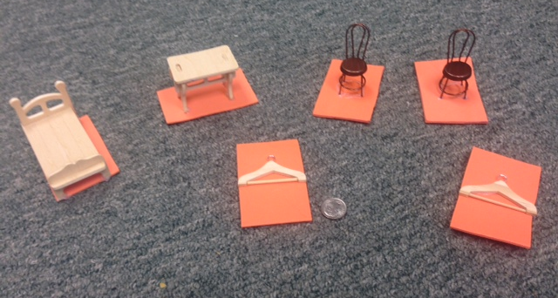
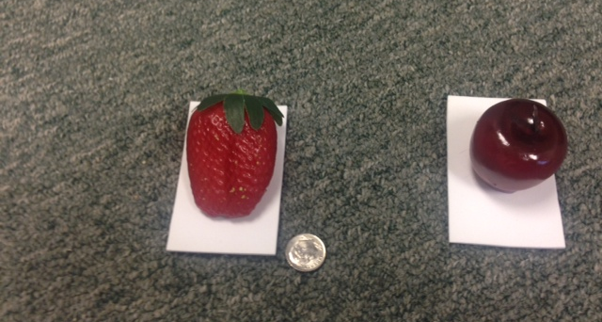
ProxTalker® in Academics
Receptive/Expressive Identification of Items
Categories
Feature, Function, Class
Sight word recognition
Group Instruction Participation
Number Identification
Quantity Matching
Coin Identification

Slide 28
Final Thoughts
At STEPS we have found that using an AAC device that incorporates a multisensory approach has increased the use of the augmentative communication.
At STEPS we have also found that by using a deconstructing communication protocol that makes language concepts more tangible, communication acquisition increased, initiation with others increased and a decrease in problem behaviors has been observed.

Slide 29
Acknowledgement
Thank you to those in attendance today.
With an immense amount of gratitude I would like to thank Logan Dobbs for helping me to understand barriers with traditional communication training that may arise.
ProxTalker® for the devices on loan and encouragement to think outside the box.
The incredible administration and staff at STEPS Center for Excellence in Autism

Slide 30
References
Boesch, Miriam, Wendt, Oliver, Subramanian, Anu & Hsu, Ning (2013). Comparative efficacy of the Picture Exchange Communication System (PECS) versus a speech generating device: Effects on requesting skills. Research in Autism Spectrum Disorders, 7, 480-493.
Bondy, Andy, Tincani, Matt & Frost, Lori. (2004). Multiply controlled verbal operants: An analysis and extension to the Picture Exchange Communication System. The Behavior Analyst, 27 (2) 247-261.
Durand, M.V. (1999) Functional Communication Training Using Assistive Devices: Recruiting Natural Communities of Reinforcement. Journal of Applied Behavior Analysis, 32, 247-267
Malhotra, Shahzadi, Rajender, Guarev, Bhatia, Manjeet. & Sing, Tej (2010). Effects of Picture Exchange Communication System on communication and behavioral anomalies in autism. Indian Journal of Psychological Medicine, 32 (2), 141-143.
Schepis, Maureen Reid, Dennis, Behrmann, Michael & Sutton, Kelly (1998). Increasing communicative interactions of young children with autism using a voice output communication aid and naturalistic teaching. Journal of Applied Behavior Analysis, 31, 561-578
Sundberg, Carl & Sundberg, Mark (1990). Comparing topography-based verbal behavior with stimulus selection-based verbal behavior. The Analysis of Verbal Behavior, 8, 31-41.
Vignes, Tore. (2007). A comparison of topography-based and selection-based verbal behavior in typically developed children and developmentally disabled persons with autism. The Analysis of Verbal Behavior, 23, 113-122.

