Slide 1
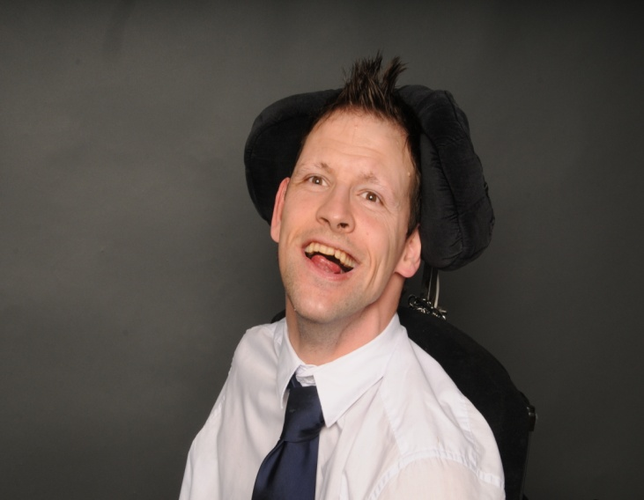
WORKING AS AN ASSISTANT UNIVERSITY LECTURER IN SPEECH, LANGUAGE & COMMUNICATION
Presented by
SCOTT STACK
Co – written by Lynsey Parrot: Senior lecturer in Linguistics and Communication Sciences

Slide 2
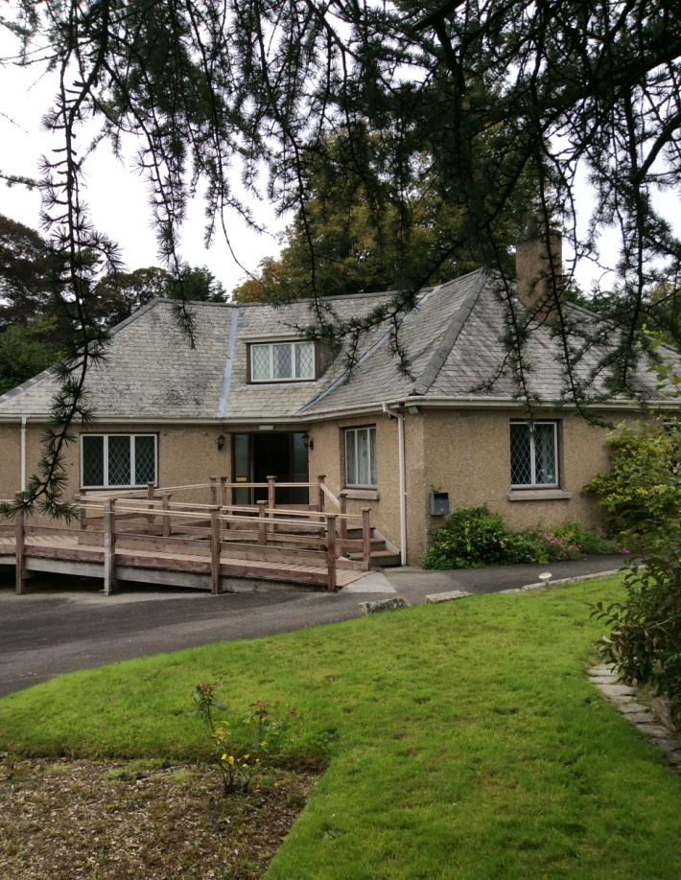
Introduction
I live in Cornerways Residential Home in Tavistock.
I want to talk to you about the job I have at The University of St Mark and St John, in Plymouth.
I have been working on a 12 week placement since January this year.
I work alongside Lynsey Parrot. (Senior lecturer in in Linguistics and Communication Sciences)
I assist with the teaching of speech and
language therapy students.
Apologies for Lynsey’s absence.

Slide 3
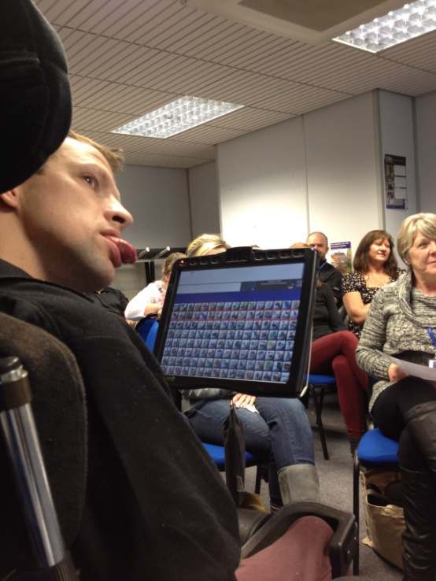
Aim and Objectives
Aim:
To tell you about my job at The University of St Mark and St John.
Objectives:
Progression of employment opportunities.
Roles and responsibilities.
To share some of my experiences.
To briefly explain about my own office.
To explain the benefits this has had for me.
Hopes for the future.
Me in a small lecture

Slide 4
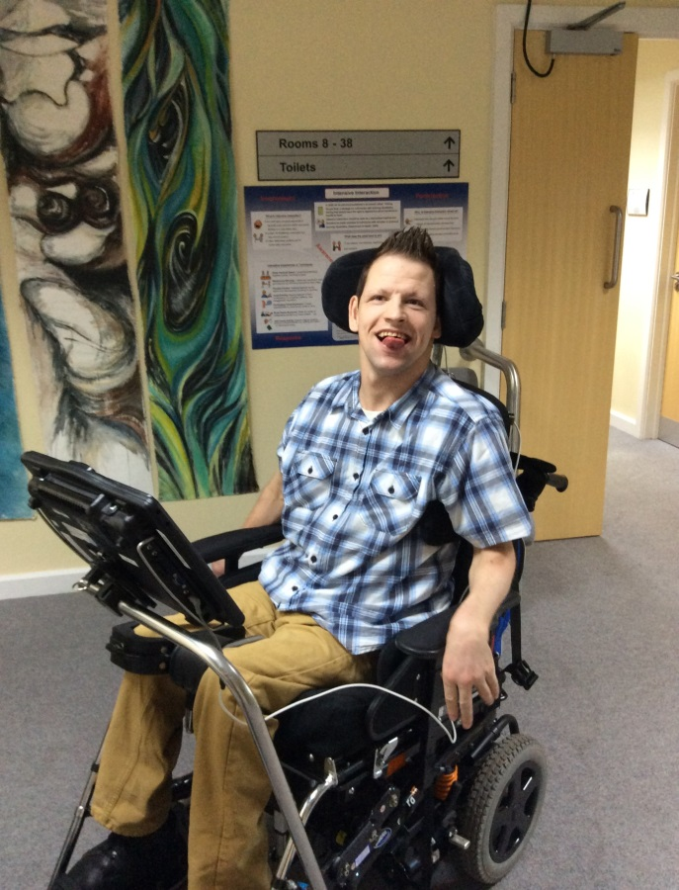
Film
I had a film made of me at my work place.
Professionals filmed me, for a full day.
They filmed me doing a ‘typical day at work’.
It is 20 minutes long.
Please watch the film in its entirety.
Then I will talk for about 20 minutes afterwards.
Questions at the end of the presentation please.

Slide 5
I hope you enjoy my film

Slide 6
Tutorials
I make formal tutorials with the students.
I tell them myself when they can enter my office.
No carers are present in my meetings.
I like being in charge and independent.
I take responsibility of the time.
I finish the meetings professionally.
The meetings allows students to get to know me and know my communication device better.
Having a tutorial with students

Slide 7
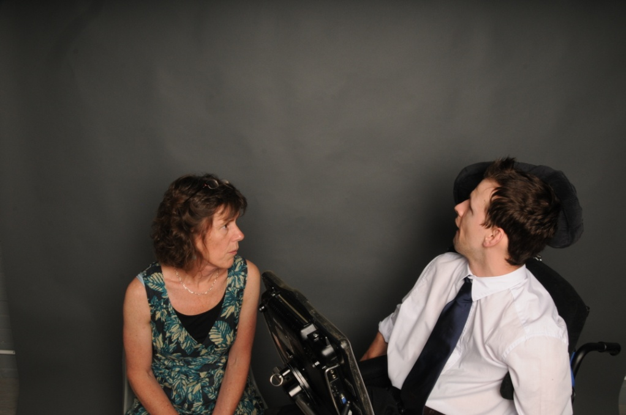
Meetings
Lynsey and I, discuss our work and discuss important decisions that need to be made, in regards to the students’ learning.
I like to be able to plan myself what I do each day that I am at work.
I like the ongoing communication I have with Lynsey.
I want to be a reliable and
professional staff member.
My boss and I have regular meetings:
She listens to me.
We make decisions and plans TOGETHER.

Slide 8
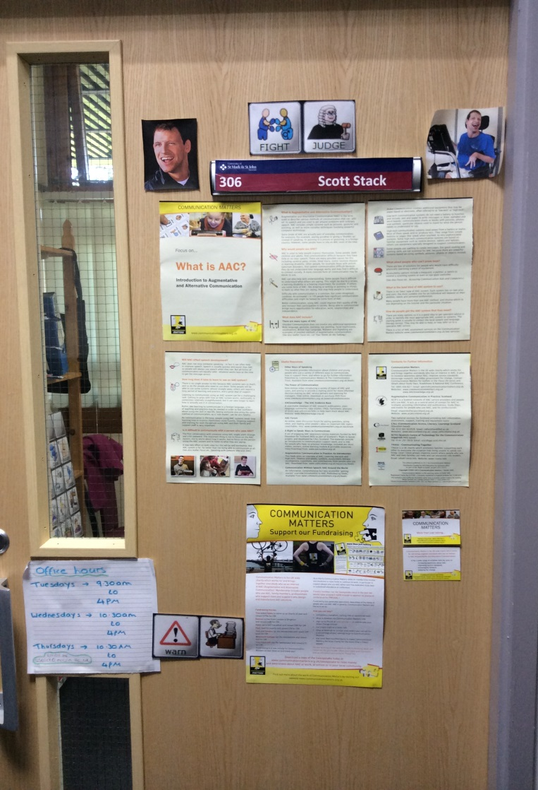
Office
I need quiet time to do my own, important work to develop my communication.
There are too many distractions in my home.
But having an office means I can focus so much more.
The door to my office

Slide 9
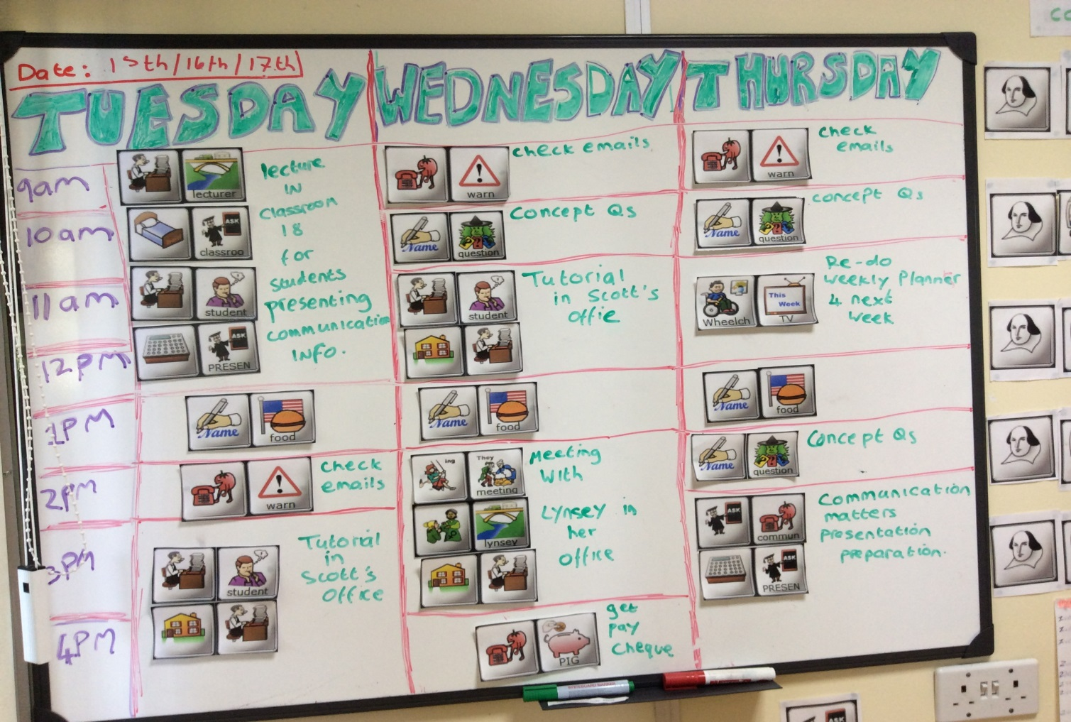
Office
I use my weekly planner
to
plan my week.

Slide 10
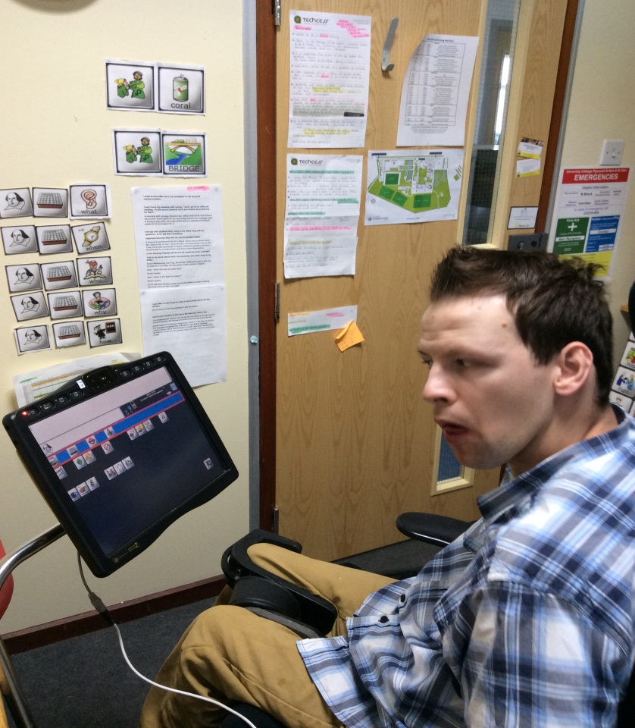
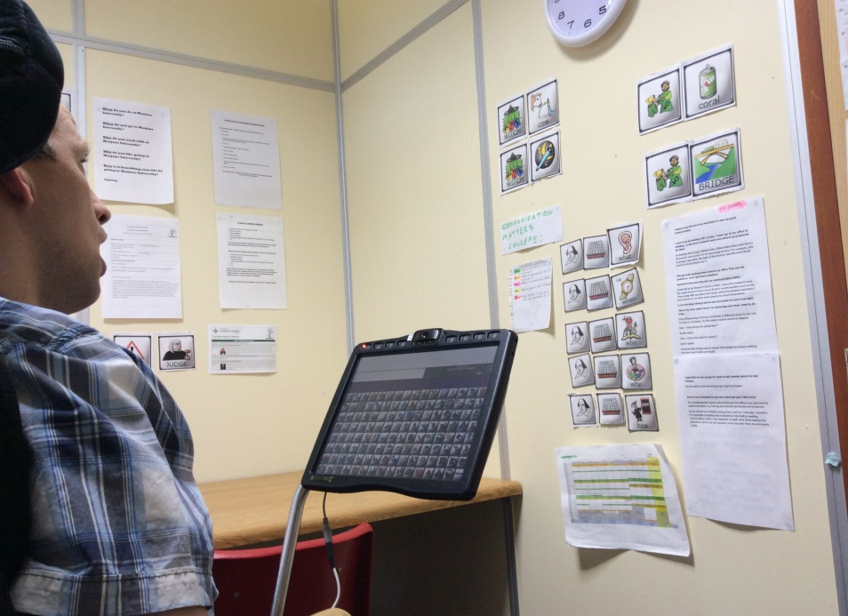
Office
I have symbols all over my office wall to assist me learning my icon sequences.

Slide 11
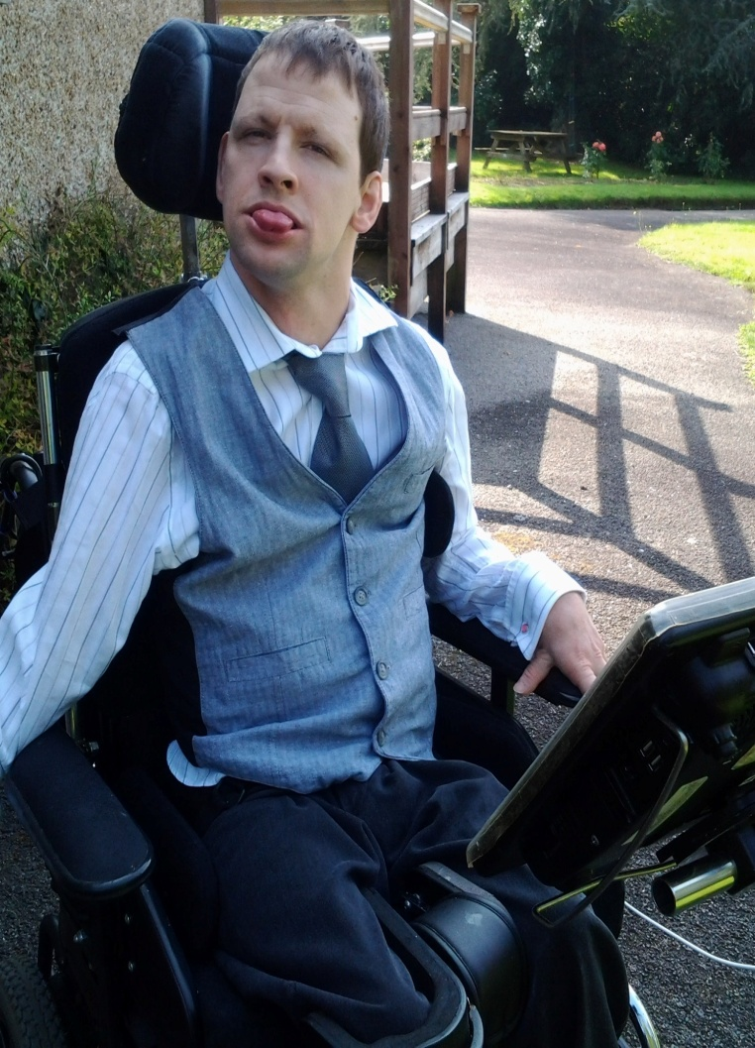
Office
I love having my own space.
I have gained much more independence.
Progression with my communication has improved very quickly.
I am responsible for telling people about what I do at work.
I dress smart when I go to work.

Slide 12
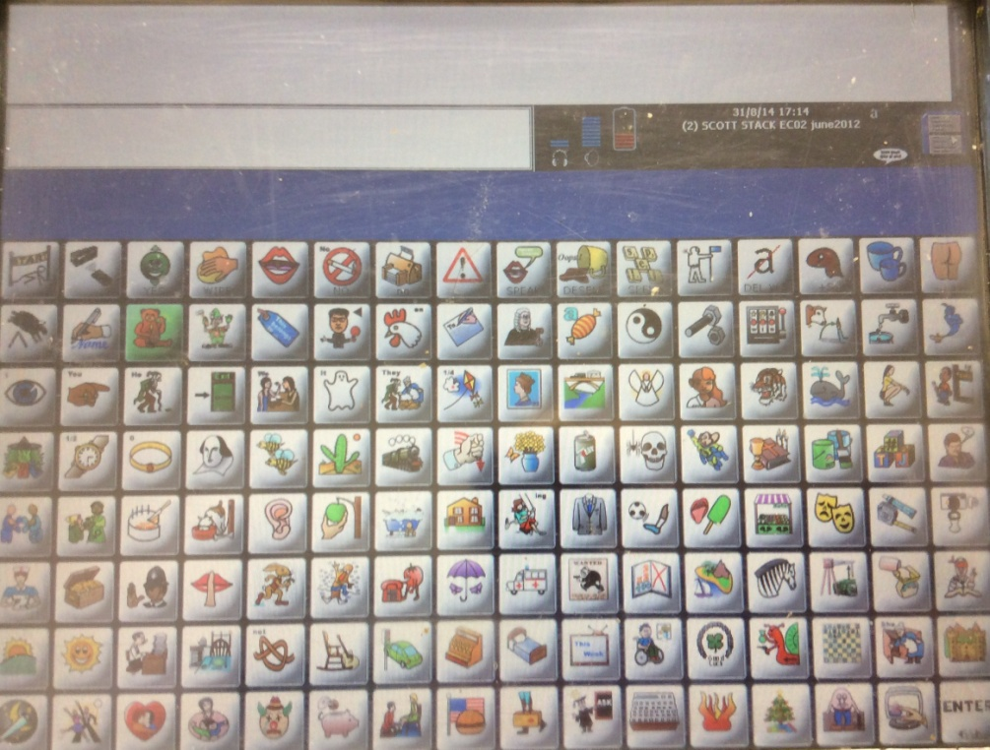
Concepts
I am now developing my communication further, to start expressing my opinions on different ideas.
I want to be able to join in conversations much easier.
To communicate, I make up sentences word by word, which takes time.
So I find it difficult to join in conversations because I cannot keep up with the speed of them talking.
The homepage of my device

Slide 13
Concepts
I have written my thoughts into my device, and they are ready to access whenever I want to.
So far I have got ideas about:
Work
I have decided to call these thoughts: concepts.
Usually, I press 2 icons to say one word, or one pre stored sentence.
But now I am learning a completely new process of choosing 3 icons, to express specific ideas on specific subjects.
My family
My Eco2
Communication Matters

Slide 14
Concepts
I have based the concepts on predicted questions I may be asked or ways I can include myself into a conversation.
The themes I have based them on are:
What?
When?
All my concepts are stored under the same first icon:
Who?
How?
Why?

Slide 15
Concepts
So for example:
“I am an assistant lecturer, for the speech and language therapy department, at the University of St Mark and St John in Plymouth.”
This second icon is the one I use for all things related to the University of St Mark and St John.
“I go to work 3 days a week: on Tuesdays, Wednesdays and Thursdays.”
Then the last icon changes depending what I specifically want to say.

Slide 16
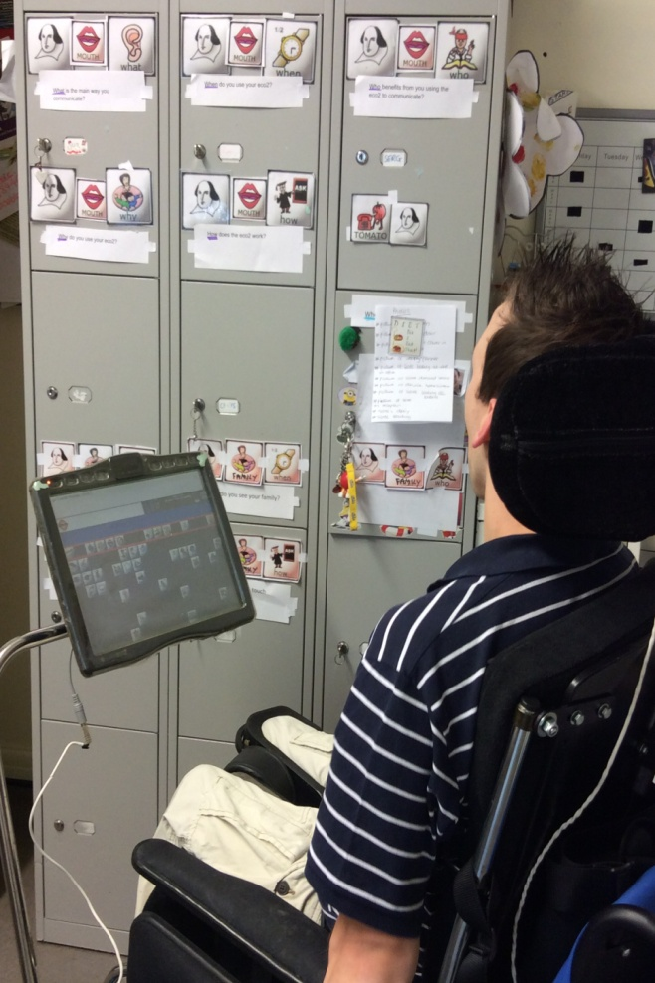
Concepts
I write the pre stored thoughts myself.
I spend a lot of time, both in my office, and at home, practicing my concepts, so that in the future I can join in conversations much easier.
I understand that this is only a brief explanation into my new way of communicating, but it is a whole different presentation in itself.
If you would like to know more about it, please see me at the end, or later on in the conference.
Practising concepts at home

Slide 17
Valued
I feel like a valued member of the work team at the University of St Mark and St John.
The staff and students have really welcomed me to their work place.
I love that all the different departments take the time to listen to me.
They all acknowledge, and try their hardest to fulfil the requests I have.
I also like that my colleagues now recognise me, and come and speak to me, when I am in work.

Slide 18
Changes
I have had to make big changes in my lifestyle, to adapt to my new work regime.
I get tired after being at work all day, but I still have things to do when I get home.
Days used to be organised around my care.
Now I organise my care around my days.

Slide 19
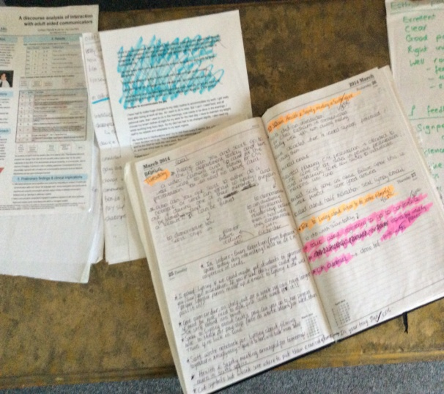
Staff
My staff also had to adapt to my work regime.
I asked 2 specific staff members, to be my support, just at work.
Their roles have changed – from carers to secretaries.
Communication between my staff is vital for the success of me working.
I also need the rest of my staff at Cornerways, to be reliable for me.
My office diary

Slide 20
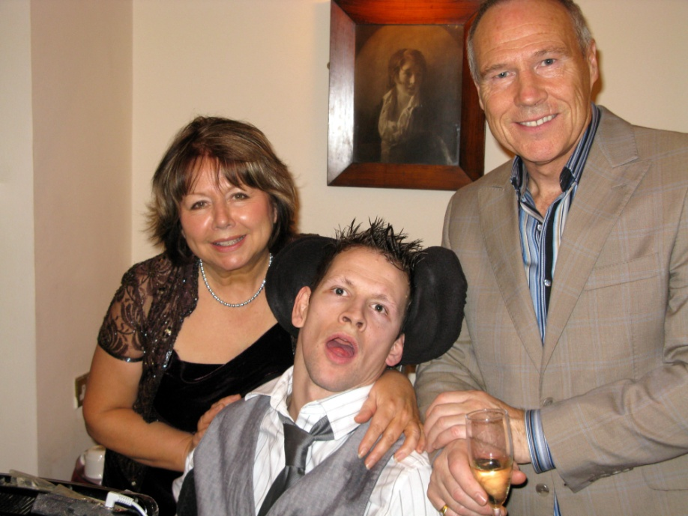
Family
My family live in Hertfordshire.
I have struggled to juggle working and visiting them, this year.
I was scared of not coping with my emotions.
This prevents me from communicating on my device properly.
Me with my Mum and Dad

Slide 21
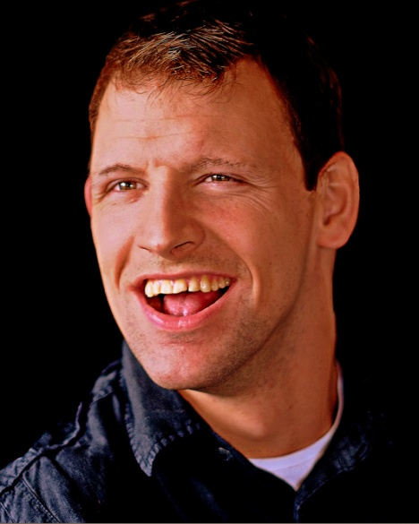
Family
But I realised I had nothing to be scared about:
Work: is it a good distraction?
Body: is my body more adaptable?
Me: Can I can do more than I think?
Or it could be a combination of all
of the above.
But I know I want to be able to maintain both my job and seeing my family.

Slide 22
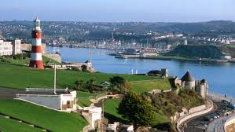
Contract
I have been offered to return to work at the University of St Mark and St John, at the start of the new term, in September.
I want a formal contract to read and sign.
I want to keep teaching university students, about speech and language therapy.
I like working 3 days a week, in Plymouth.

Slide 23
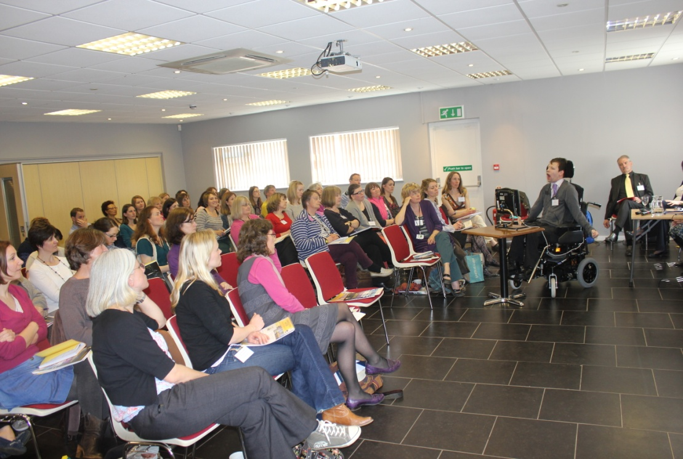
Inspire
I want to inspire those with AAC and other disabilities that they can work.
I want to encourage others to be ambitious.
I AM PROOF OF THAT.
I love working – I do not want to stop.
I love surprising people when I tell them about my job.

Slide 24
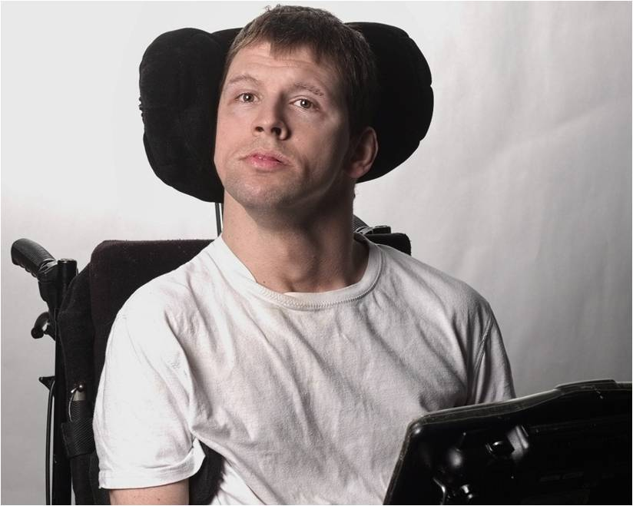
Finish
Thank you for your time, and for listening to me.
I will do my best to
answer your questions.
Email me at: sstack@marjon.ac.uk

Slide 25
WORKING AS AN ASSISTANT UNIVERSITY LECTURER IN SPEECH, LANGUAGE & COMMUNICATION
Presented by
SCOTT STACK
Co – written by Lynsey Parrot: Senior lecturer in Linguistics and Communication Sciences

