Slide 1
A Right to Speak Supporting pupils with communication difficulties
David Fletcher
Principal Teacher – AAC
Forth Valley Right to Speak Partnership

Slide 2
Schools pack can be requested from: aac@stirling.gov.uk

Slide 5
Population (2013)
Falkirk - 157,140
Stirling - 91,260
Clackmannanshire - 51,280
Forth Valley 300,580
Notes:
Groscotland.gov.uk

Slide 6
Background
The Scottish Government launched the Right to Speak initiative in 2012 to improve services to users of Augmentative and Alternative Communication (AAC)

Slide 7
Background
The Forth Valley Right to Speak Partnership was formed including professionals from NHS, Education and Social Work
Remit to leave a legacy of improved services for AAC users when A Right to Speak initiative ends in March 2015
Unlike some areas of Scotland, Forth Valley does not have a central AAC service

Slide 9
Why AAC matters to schools
A pupil with communication difficulties could enrol at any time
It’s already the responsibility of schools to support pupils with communication difficulties
Education (Additional Support for Learning) (Scotland) Acts 2004 and 2009
Getting it Right for Every Child
A Curriculum for Excellence
How Good Is Our School? Quality indicators
GTCS Professional Standards for Teachers

Slide 10
General Teaching Council for Scotland Standards for Teacher Registration
AAC specific strands | Professional Standards for Teachers in Scotland
1. Identification of Need | 2. Professional Knowledge and Understanding —2.3.1 —3.1.4
2. Assessment | 2. Professional Knowledge and Understanding —2.1.5 3. Professional Skills and Abilities —3.1.1
3. Implementation | 2. Professional Knowledge and Understanding —2.1.2
4. Review | 2. Professional Knowledge and Understanding —2.3.1 —3.1.1
(Source: IPAACKS, NHS Education for Scotland)
More information at http://www.gtcs.org.uk/standards/standards.aspx

Slide 11
A Curriculum for Excellence
Technologies: ICT to enhance learning
I can create, capture and manipulate sounds, text and images to communicate experiences, ideas and information in creative and engaging ways. TCH 1-04b / TCH 2-04b
Literacy and English - Listening and Talking: Creating Texts
I can communicate clearly when engaging with others within and beyond my place of learning, using selected resources as required. LIT 1-10a

Slide 12
How Good is Our School? Reflective Questions for Self Evaluation
What do teachers / staff do to ensure that the needs of learners with communication difficulties are met within the class / playroom?
How does the school / centre make use of input of health, social work and other partner agencies, and parents and carers in meeting young people’s learning needs?
How effectively do we support and challenge learners with communication difficulties by choosing learning tasks, resources and activities which are well matched to their needs, progress or attainments?
Do we have appropriate expectations for Iearners with communication difficulties?

Slide 13
Difficulties faced by schools
Staff not trained – don’t know where to start
Relying on outreach support from Additional Support Needs services or speech and language therapists
No time to produce resources

Slide 14
Bringing together good practice
NHS Education for Scotland
CALL (Communication, Access, Literacy and Learning) Scotland, University of Edinburgh
Fife AAC Team (FAACT)
KEYCOMM (Lothians AAC Service)
Communication Matters
Forth Valley Right to Speak Partnership

Slide 15
Schools Pack Sections
Ways to communicate and CPD opportunities for staff
First steps for schools when a pupil with communication difficulties is enrolled
AAC assessment process
Links to curriculum and standards for schools and teachers
Supporting high-tech AAC users – roles for school staff
Communication resources
CD-ROM

Slide 16
Training videos www.aacscotland.org.uk

Slide 17
Online Learning Modules www.aacscotland.org.uk
Notes:
More modules to be added later

Slide 18
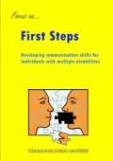
Further reading
Communication Matters leaflets

Slide 19
Further reading
Books available to borrow
Notes:
Some available as free downloads

Slide 20
What to do when a pupil with communication difficulties is enrolled
Practical strategies for schools to follow while awaiting outreach support and assessment
Nothing in this guidance replaces personalised children’s plans

Slide 21
Checklist
Gather information
Begin staged intervention
Seek assistance
Symbolise your environment
Use specimen communication resources
Make your own communication resources
Training
Voice output devices
Use pupil voice

Slide 22
Information on AAC Assessments

Slide 23
Suggested roles for schools
Support for Learning Co-ordinator
Communication Champion
Teachers
Communication Assistant
Communication Partners
Technical Support Assistant
Plus roles for outreach teachers

Slide 24
Informing and Profiling AAC Knowledge and Skills (IPAACKS)
Published by NHS Education for Scotland in January 2014
Supporting the learning and development of people working with individuals who use AAC
http://tinyurl.com/ipaacks

Slide 25
Core values and commitments
Working in partnership
Respecting diversity
Challenging inequality
Promoting opportunity
Promoting inclusion and participation
Promoting emotional, psychological and physical wellbeing
Promoting positive interaction

Slide 26
AAC Specific Strands
Identifying need
AAC assessment
Implementation
Review
Technology – preparation, adaptation and integration
Technology – management of resources
AAC Leadership
Facilitating AAC learning
Notes:
Looked at how these roles could look for members of staff in schools

Slide 28
All teachers

Slide 29
Teachers with an AAC user in their class

Slide 30
Support for learning co-ordinator

Slide 31
Communication champion

Slide 32
Communication assistant

Slide 33
ICT outreach teacher

Slide 34
Knowledge and skills factsheets

Slide 35
Knowledge and skills factsheets
Suggested best practice for schools and outreach staff
Helps to identify appropriate staff to support AAC users
Identify professional development priorities
Gives clarity to each person’s role.

Slide 36
Knowledge and skills factsheets
AAC SPECIFIC KNOWLEDGE AND SKILLS: IDENTIFYING NEED
Skill level | Outcome for the person using AAC | AAC specific capability | What workers know | What workers are able to do (skills)
1 | People recognise when I am having problems with my communication | Identifying a communication support need | Aware of typical language and communication development and abilities | Recognise when someone has communication support needs

Slide 37
Suggested roles for communication assistants
Support AAC Users with challenges in communication.
Help the AAC user to produce appropriate messages.
Prompt the AAC user.
Attend training on programming and using devices used by individual users.
Assist with the production of personalised communication resources for pupils.
Program and customise the device for the user e.g. by adding vocabulary.
Maintain hygiene of devices.
Report faults to the technical support assistant.

Slide 38
Communication Boards
CALL Scotland / NHS Education for Scotland

Slide 39
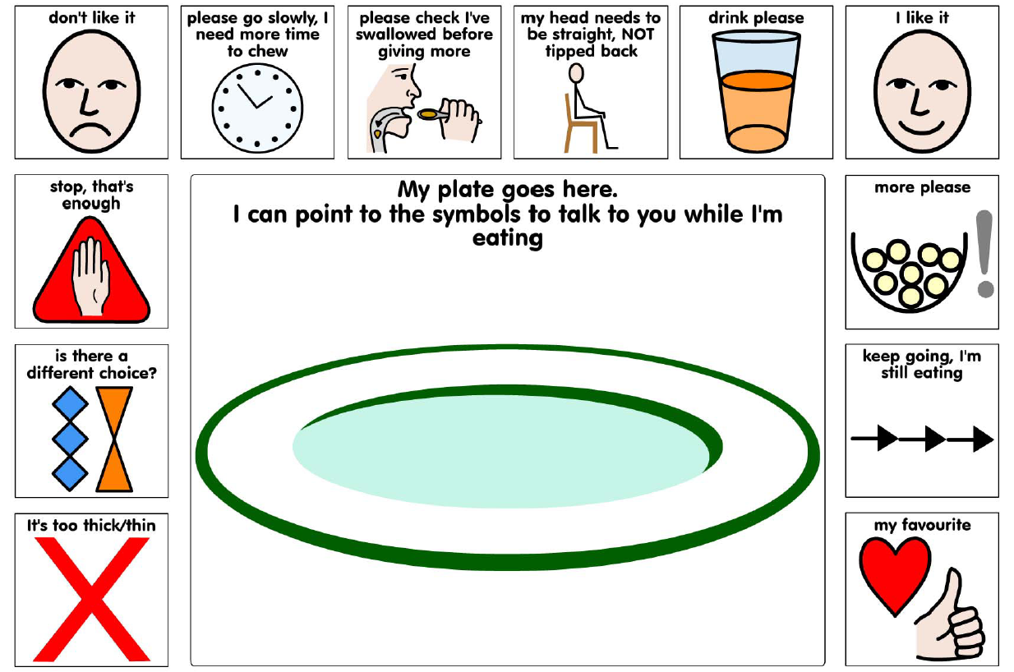
Communication Boards
CALL Scotland / NHS Education for Scotland

Slide 40
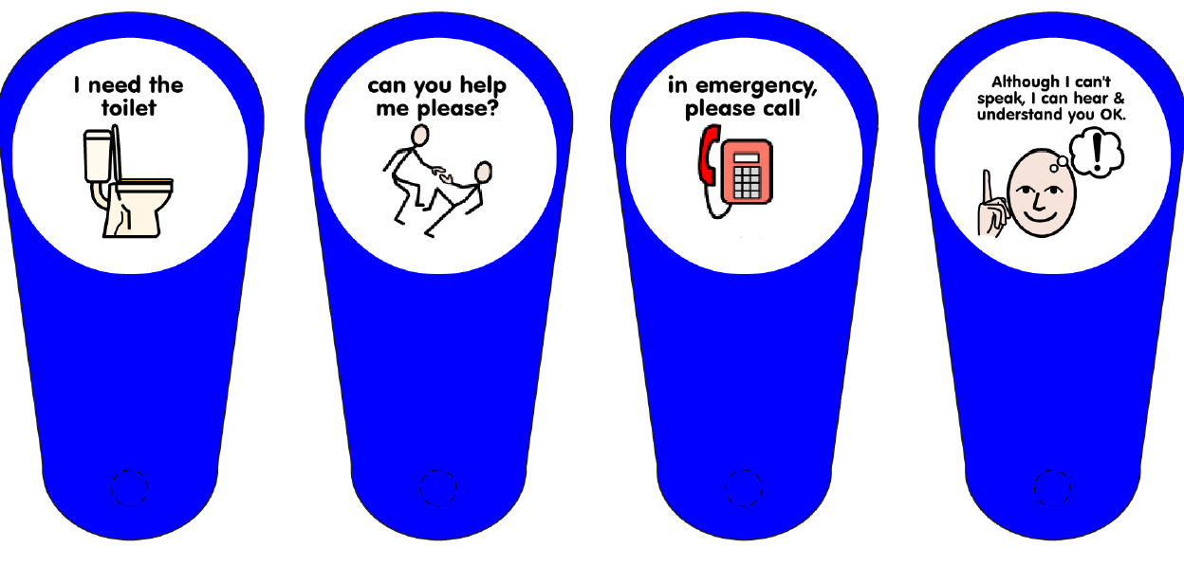
Communication Boards
CALL Scotland / NHS Education for Scotland

Slide 41
Symbolised schools resources
FAACT, Fife Council
Notes:
Kind permission from Dynavox Mayer Johnson to share 100 PCS symbols. Boardmaker was used almost exclusively in Forth Valley – other symbol sets are available and I am not endorsing any particular program or symbol set.

Slide 42
Symbolised schools resources
FAACT, Fife Council

Slide 43
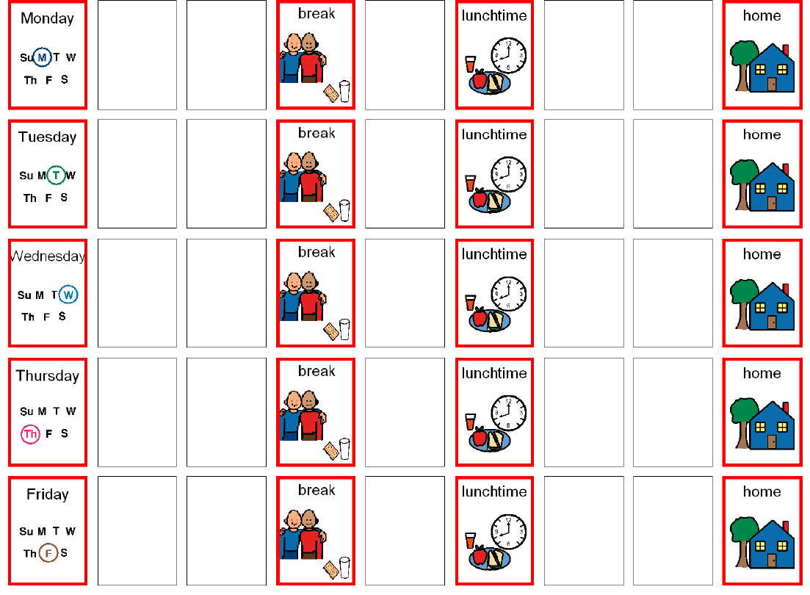
Symbolised schools resources
FAACT, Fife Council

Slide 44
Summary of pack contents
CPD resources for staff
First steps for schools when a pupil with communication difficulties is enrolled
Education rationale linked to teacher standards, inspection framework and curriculum
Suggested roles for school staff with knowledge and skills mapped to IPAACKS
Exemplar materials including communication boards and a pack to symbolise the school environment

Slide 45
Some final points
Designed as local guidance for Forth Valley
Intended to raise capacity within schools to support pupils with communication support needs, as a legacy of A Right to Speak
Happy to share the resources for you to adapt for your local circumstances

Slide 46
Schools pack can be requested from: aac@stirling.gov.uk

