Slide 1
Improving Privacy in Communication Aids
Jack Browne, Mcomp – Jack@e-g-c.co.uk
Dr. Peter O’Neill, PHD – P.O’Neill@shu.ac.uk

Slide 2
About the authors
Jack Browne
Occupation: Computer and Information Security at Kilco IT
Masters in Computer and Information Security at Sheffield Hallam University
Specific Focus: User security & seamless security
Dr. Peter O’Neill
Occupation: Senior Lecturer at Sheffield Hallam University
PhD Title: "Enhancing the Prescription of Electronic Assistive Technology"
Previous Employment: Barnsley Hospital NHS Foundation Trust and the University of Sheffield, Madhouse Software Production Ltd

Slide 3
Background to the research
Masters level group project
Combined multiple disciplines
Applied the skills to an unknown environment
Goal: Produce a VOCA for a specific disability profile
Discipline specific research
Investigate what work has been done
Identify any gaps in current research
Try to improve VOCAs by utilising your own skillset

Slide 4
Initial thoughts
Highly sceptical
Inverse relationship between usability and security
Communication aids must focus on usability
Average conversation 120-180 words/minute (Hawking 2004)
Average typist 40-60 words/minute
Communication aids are significantly lower
However
Little or no research into communication aid security
Opportunity to improve security with minimal usability impact

Slide 5
Information Security Triad
Confidentiality
“Protecting the information from disclosure to unauthorised parties”
Integrity
“Maintaining the consistency, accuracy, and trustworthiness of data over its entire life cycle”
Availability
“Providing a certain measure of redundancy and failover”

Slide 6
The Triad in VOCAs
Integrity
Very small chance of input or output being tampered with
Short data lifecycle
Availability
Extended batteries
Redundant power supply
Reliable operating systems
Confidentiality
Information input is unprotected
Information output is unprotected

Slide 7
Insecure Input of Information
Input screens publicly viewable
Designed around usability
Maximum visibility
What if…
User wants to communicate private information
Address/phone details
Bank details
Medical information
Anyone within view of the screen can read it!

Slide 8
Insecure Output of Information
Many VOCAs use a speaker
Anyone in the room can hear the speaker
Only supports 1-to-many communication
What if…
User wants to communicate private information
Address/phone details
Bank details
Medical information
Anyone in the room can hear it!

Slide 9
Aims
To improve privacy/confidentiality in communication aids
Securing the input of information
Securing the output of information
Minimise impact on usability of communication aids – irrelevant of disability

Slide 10
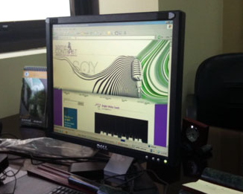
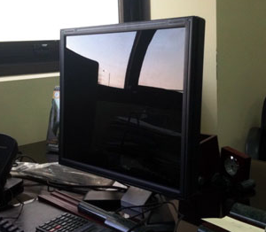
Input of Information - Solutions
Common problem in many areas
Mobile computing
Public kiosks
ATMs
Solution: Physical Privacy Filters
Applied over the screen as a film
Only allow viewing from a perpendicular angle
Side, top & bottom view obscured

Slide 11
Physical Privacy Filters
Advantages
Cheap to produce
Easy to use
Adaptable to many devices
Can be retro-fitted
Disadvantages
Filters sometimes fall off
What if the screen angle is knocked and user has physical disability?

Slide 12
Software Based Privacy Filters
Laptop with privacy mode – Dell (2008)
Turned on/off instantly
Cost ~£83.50
Small in comparison to cost of advanced communication aids

Slide 13
Software Based Privacy Filters
Advantages
Can be enabled/disabled at the touch of a button
Can be used with minimal effort
Relatively cheap to implement
Disadvantages
Requires installation of additional privacy button
Can’t be retro-fitted to devices
Overall appeared to be a robust and adaptable solution

Slide 14
So far…
Software based privacy filter
Secures the input of data to devices
Doesn’t secure the output of data
Users should be able to communicate information discretely
Support 1-to-1 communication
Not all communication is suitable for 1-to-many output

Slide 15
Just Talk V1.0
Madhouse Software
Supported multiple selection layers
Originally used to convey emotion
Allows for volume selection on output
0.5 second hold → Layer 1 → Whisper
1.0 second hold → Layer 2 → Speak
1.5 second hold → Layer 3 → Shout
Layers can be prioritised based on frequency
Improvement:
Allow ‘whisper’ option to be routed to headphones

Slide 16
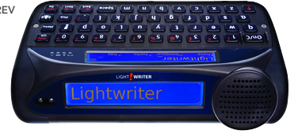
Routing Audio to Headphones
Problem
What if communication recipient is unable to pick up headphones?
What if communication recipient is deaf?
Solution
Install an additional output screen
Toby Churchill Lightwriter SL40
Whispering = Screen + Headphones
Speaking/Shouting = Screen + Speaker
Apply digital privacy filter to both input and output screens

Slide 17
Combination of solutions
A communication aid which…
Allows information to be input privately
Supports discrete 1-to-1 communication
Supports disabilities in both users and conversation recipients
Minimal impact on usability
Minimal increase in cost
Lessons learned are more important…

Slide 18
Lessons Learned
Usability improvements are a priority
Aim for conversational speech
Increase independence of users
Range of use increases
Result: A need for devices which support discrete communication
Minimal demand at the moment
It’s ok to be ahead of the curve
We don’t need to re-invent the wheel
Important not to get tunnel vision
Communication involves more than words per minute
Direction, emotion, independence

Slide 19
Thank you
Any questions?

